Slide 1
Algoritma & Pemrograman
Control Flow (1)
Prepared by
Frans Panduwinata, S.Kom, M.T

Slide 2
Loops
Loops are used to perform a set of instructions repeatedly.
The set of instructions to be iterated is called the loop body.
C++ offers three language elements to formulate iteration statements: while, do-while, and for.
The number of times a loop is repeated is defined by a controlling expression.

Slide 3
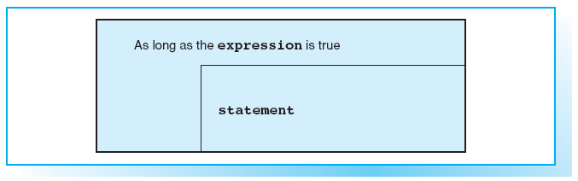
Structogram for while

Slide 4
The while Statement
The while statement takes the following format:
SYNTAX:
while( expression )
statement // loop body

Slide 5
The while Statement (cont)
When entering the loop, the controlling expression is verified, i.e. the expression is evaluated.
  If this value is true,
  the loop body is then executed before the controlling expression is evaluated once more.
  If the controlling expression is false,
  i.e. expression evaluates to false, the program goes on to execute the statement following the while loop.

Slide 6
Building Blocks
If you need to repeat more than one statement in a program loop, you must place the statements in a block marked by parentheses { }.
A block is syntactically equivalent to a statement, so you can use a block wherever the syntax requires a statement.

Slide 7
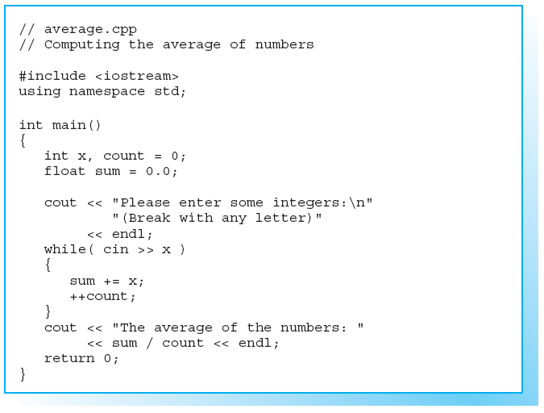
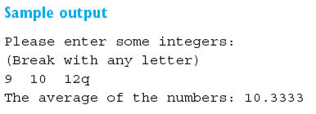
Sample Program

Slide 8
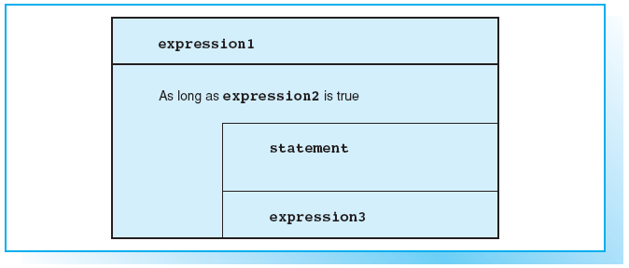
Structogram for for

Slide 9
Initializing and Reinitializing
A typical loop uses a counter that is initialized, tested by the controlling expression and reinitialized at the end of the loop.
EXAMPLE:
int count = 1; // Initialization
while( count <= 10) // Controlling expression
{
cout<<count<< ". loop"<<endl;
++count; // Reinitialization
}

Slide 10
Initializing and Reinitializing (cont)
In the case of a for statement the elements that control the loop can be found in the loop header.
SYNTAX:
for( expression1; expression2; expression3 )
statement
  expression1 is executed first and only once to initialize the loop.
  expression2 is the controlling expression, which is always evaluated prior to executing the loop body:
    if expression2 is false, the loop is terminated
    if expression2 is true, the loop body is executed. Subsequently, the loop is reinitialized by executing expression3 and expression2 is re-tested.

Slide 11
Initializing and Reinitializing (cont)
EXAMPLE:
int count;
for( count = 1; count <= 10; ++count)
cout << count<< ". loop" << endl;
EXAMPLE:
for( int i = 0; i < 10; cout << i++ )
;
As this example illustrates,
  The loop body can be an empty statement.
  This is always the case if the loop header contains all necessary statements.
  However, to improve readability, even the empty statement should occupy a line of its own.

Slide 12
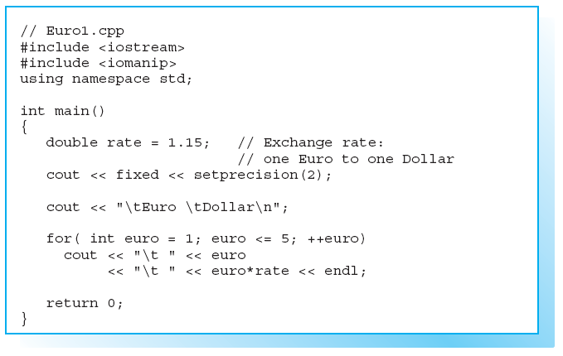
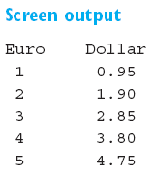
Sample Program

Slide 13
The Comma Operator
You can use the comma operator to include several expressions where a single expression is syntactically correct.
SYNTAX:
expression1, expression2 [, expression3 ...]
The expressions separated by commas are evaluated from left to right.

Slide 14
The Comma Operator (cont)
EXAMPLE:
int x, i, limit;
for( i=0, limit=8; i < limit; i += 2)
x = i * i, cout << setw(10) << x;
The comma operator separates the assignments for the variables i and limit and is then used to calculate and output the value of x in a single statement.

Slide 15
The Comma Operator (cont)
EXAMPLE:
x = (a = 3, b = 5, a * b);
In this example the statements in brackets are executed before the value of the product of a * b is assigned to x.

Slide 16
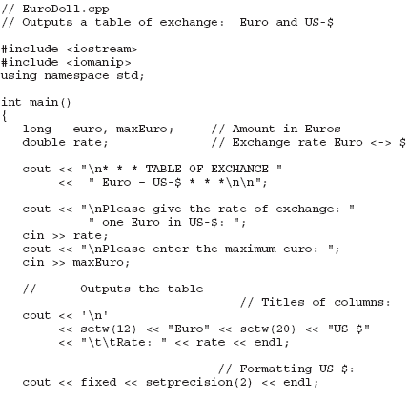
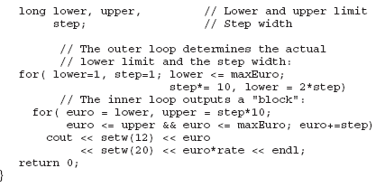
Sample Program

Slide 17
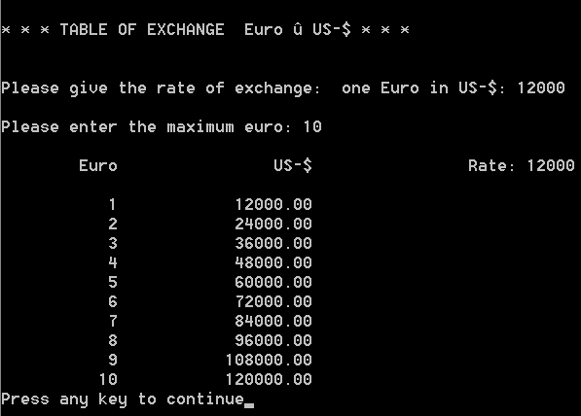
Sample Program (cont)
Screen Output:

Slide 18
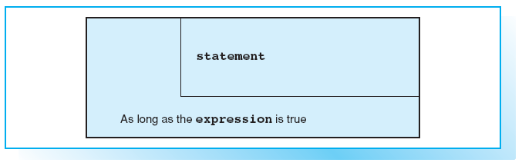
Structogram for do-while

Slide 19
The do-while Statement
In contrast to while and for loops, which are controlled by their headers,
the do-while loop is controlled by its footer.
This results in the loop body being performed at least once.
SYNTAX:
do
statement
while(expression);

Slide 20
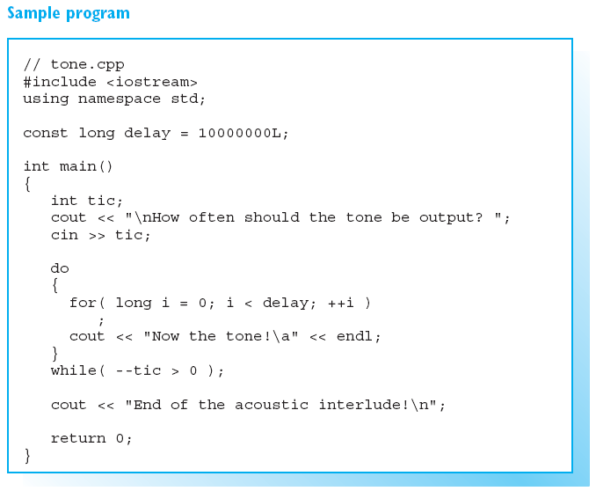
Nesting Loops
Loops can be nested, that is, the loop body can also contain a loop.
The ANSI standard stipulates a maximum depth of 256 nested loops.

Slide 21
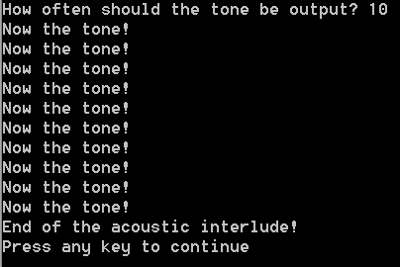
Nesting Loops (cont)
Screen Output:

Slide 22
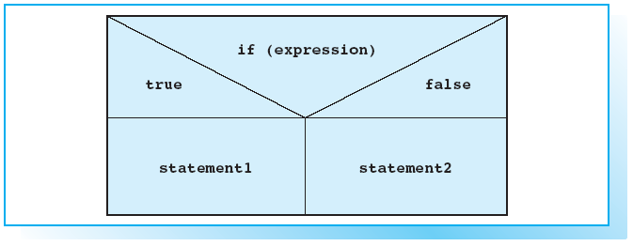
Structogram for the if-else Statement

Slide 23
Selections with if-else
The if-else statement can be used to choose between two conditional statements.
SYNTAX:
if( expression )
statement1
[ else
statement2 ]
  expression is first evaluated.
  If the result is true, statement1 is executed and statement2 is executed in all other cases, provided an else branch exists.
  If there is no else and expression is false, the control jumps to the statement following the if statement.

Slide 24
Nested if-else Statements
Multiple if-else statements can be nested. But not every if statement has an else branch.
EXAMPLE:
if( n > 0 )
if( n%2 == 1 )
cout << " Positive odd number ";
else
cout << "Positive even number";
  In this example, the else branch belongs to the second if.
  An else branch is always associated with the nearest preceding if statement that does not have an else branch.

Slide 25
Nested if-else Statements (cont)
However, you can use a code block to redefine the association of an else branch.
EXAMPLE:
if( n > 0 )
{
if( n%2 == 1 )
cout << " Positive odd number \n";
}
else
cout << " Negative number or zero\n";

Slide 26
Defining Variables in if Statements
You can define and initialize a variable within an if statement.
The expression is true if converting the variable’s value to a bool type yields true.
EXAMPLE:
if( int x = func() )
{ . . . } // Here to work with x.
  The return value of the function, func(), is used to initialize the variable x.
  If this value is not 0, the statements in the next block are executed.
  The variable x no longer exists after leaving the if statement.

Slide 27
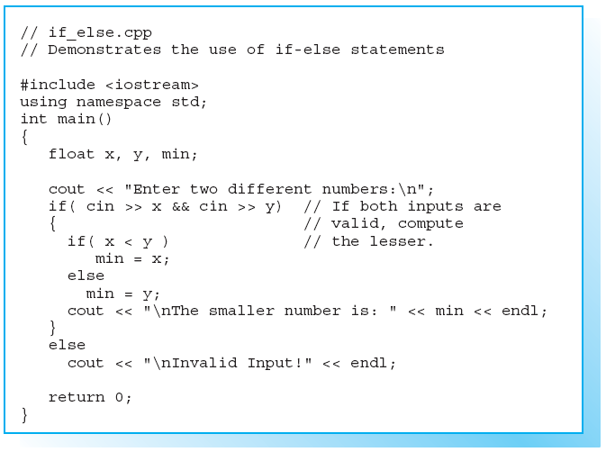
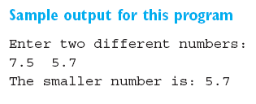
Sample Program

Slide 28
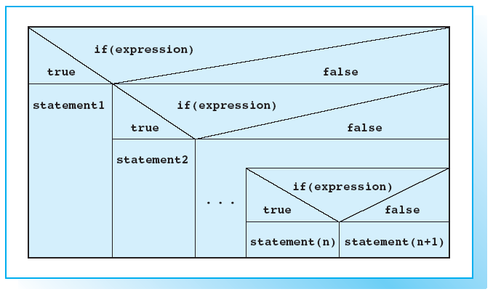
Structogram for an else-if Chain

Slide 29
Layout and Program Flow
You can use an else-if chain to selectively execute one of several options.
SYNTAX:
if ( expression1 )
statement1
else if( expression2 )
statement2
.
.
.
else if( expression(n) )
statement(n)
[ else statement(n+1)]

Slide 30
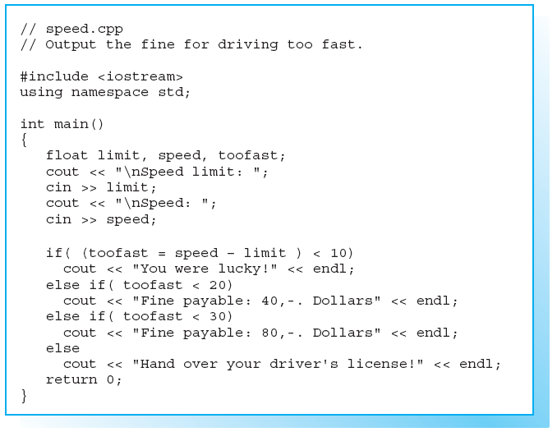
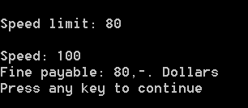
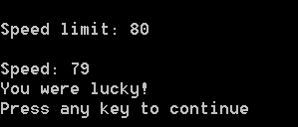
Sample Program
Screen Output:
Screen Output:

Slide 31
EXERCISES

